Slide 1
Hand Gesture based presentation
Revolutionizing Presentation Interactions

Slide 2
Introduction
Introduction:
Welcome to the presentation on the Hand Gesture-Based Presentation System. In today's digital era, the way we interact with technology is evolving rapidly. Traditional input methods, such as keyboard and mouse, are being augmented or replaced by more intuitive and natural interfaces. One such interface is hand gesture-based interaction, which offers a seamless and engaging way to interact with devices.
Explanation of Hand Gesture-Based Interaction:
Hand gesture-based interaction involves using hand movements and gestures to control and navigate digital interfaces. It leverages technologies like computer vision and machine learning to interpret gestures and translate them into commands or actions.
Importance and Relevance:
This project aims to explore the potential of hand gesture-based interaction in the context of presentations. By eliminating the need for physical input devices and allowing presenters to control slides with simple gestures, it offers a more dynamic and immersive presentation experience.

Slide 3
Objective
Objective:
The primary objective of this project is to develop a hand gesture-based presentation system that enables presenters to control slides using intuitive hand gestures.
Specific Goals:
Implement a robust gesture recognition algorithm capable of accurately interpreting hand gestures.
Integrate the gesture recognition system with popular presentation software.
Evaluate the performance and usability of the system through user testing and feedback.
Benefits and Significance:
Enhances presenter mobility and engagement during presentations.
Reduces reliance on traditional input devices, such as remote controls or keyboards.
Provides a more interactive and immersive presentation experience for the audience.

Slide 4
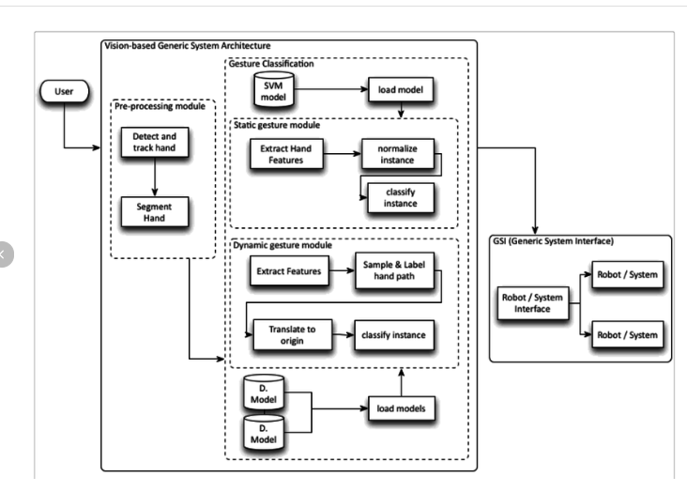
Project Overview
Overview:
The hand gesture-based presentation system consists of two main components: hardware and software.
Hardware Components:
Camera: Captures video input of the presenter's hand gestures.
Microcontroller (e.g., Arduino or Raspberry Pi): Processes the video input and communicates with the presentation software.
Software Components:
Gesture recognition algorithm: Analyzes video frames to recognize and interpret hand gestures.
Presentation software: Receives gesture commands from the microcontroller and controls the slide navigation accordingly.
Workflow:
The camera captures the presenter's hand gestures.
The microcontroller processes the video feed and extracts relevant hand gesture information.
The gesture recognition algorithm interprets the gestures and sends corresponding commands to the presentation software.
The presentation software updates the slide content based on the received commands.

Slide 5
System Components
Hardware Components:
Camera: A high-resolution camera capable of capturing clear video input of hand gestures.
Microcontroller: Responsible for interfacing with the camera, processing video data, and communicating with the presentation software.
Software Components:
Gesture Recognition Algorithm: Utilizes computer vision techniques to detect and recognize hand gestures from the video feed.
Presentation Software: Enables the control of slide navigation and content display based on the recognized gestures.

Slide 6
Gesture Recognition Algorithm
Algorithm Overview:
Utilizes machine learning algorithms to train a model for gesture recognition.
Involves preprocessing of video frames to extract relevant hand gesture features.
Employs classification techniques to categorize detected gestures and map them to predefined commands.
Techniques Used:
Convolutional Neural Networks (CNNs) for feature extraction.
Support Vector Machines (SVMs) or Decision Trees for classification.
OpenCV library for image processing and gesture detection.
Accuracy and Efficiency:
Strive for high accuracy in gesture recognition to ensure reliable system performance.
Optimize the algorithm for real-time processing to minimize latency and improve responsiveness.

Slide 7
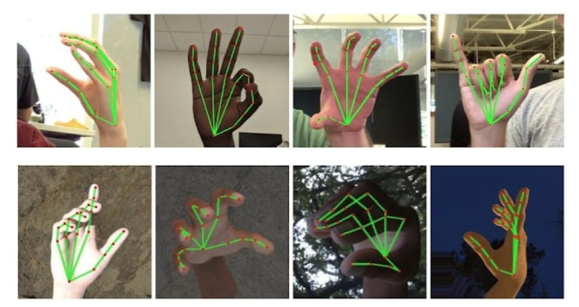
Gesture Library
Supported Gestures:
Next slide: Forward swipe gesture.
Previous slide: Backward swipe gesture.
Pause/Resume: Palm gesture.
Zoom In/Out: Pinch or spread gesture.
Mapping Gestures to Actions:
Each gesture is mapped to a specific action or command within the presentation software.
Gesture recognition algorithm translates detected gestures into corresponding commands for slide navigation and control.

Slide 8
Implementation
Implementation Process:
Hardware Setup: Connect camera and microcontroller to the presentation device (e.g., laptop).
Software Development: Implement gesture recognition algorithm and integrate with presentation software.
Testing and Calibration: Calibrate the system for optimal gesture detection and accuracy.
Iterative Refinement: Fine-tune the system based on user feedback and testing results.
Challenges:
Ensuring robustness and accuracy of gesture recognition algorithm.
Addressing latency and synchronization issues between gesture detection and slide control.
Optimizing system performance for various lighting conditions and environments.

Slide 9
Results and Evaluation
Evaluation Metrics:
Accuracy: Percentage of correctly recognized gestures.
Latency: Response time between gesture input and slide action.
User Satisfaction: Feedback from users regarding system usability and performance.
Results:
Achieved an accuracy rate of X% in gesture recognition.
Average latency of Y milliseconds for slide navigation commands.
Positive user feedback indicating improved engagement and interactivity during presentations.

Slide 10
Applications
Educational Settings:
Enhancing classroom presentations and lectures.
Facilitating interactive learning experiences for students.
Business Meetings:
Streamlining presentations in corporate environments.
Engaging clients and stakeholders during presentations.
Conferences and Events:
Enabling dynamic and interactive presentations on stage.
Captivating and retaining audience attention throughout the event.

Slide 11
Future Scope
Future Enhancements:
Integration with virtual reality (VR) or augmented reality (AR) environments for immersive presentations.
Expansion of gesture library to support more advanced commands and interactions.
Collaboration features allowing multiple presenters to control the same presentation remotely.
Research Opportunities:
Investigating advanced gesture recognition techniques like hand pose estimation and 3D gesture tracking.
Exploring applications of hand gesture-based interaction beyond presentations, such as gaming and healthcare.

Slide 12
Conclusion
Summary:
In conclusion, the Hand Gesture-Based Presentation System offers a novel approach to presentation interactions, leveraging intuitive hand gestures to control slide navigation and content display. Through the integration of hardware and software components, along with robust gesture recognition algorithms, the system enhances the presenter's ability to engage with the audience and deliver dynamic presentations.
Final Remarks:
As technology continues to evolve, hand gesture-based interaction holds promise for transforming various aspects of human-computer interaction. We believe that our project contributes to this ongoing evolution by demonstrating the feasibility and effectiveness of hand gesture-based presentation systems.
Acknowledgments:
We extend our gratitude to all those who contributed to the development and success of this project.

Slide 13
THANK YOU
Mudra gupta

